Slide 1


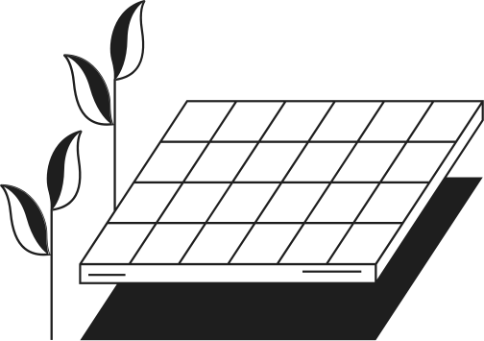


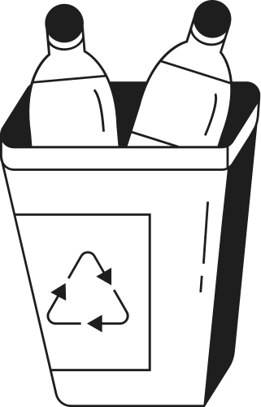







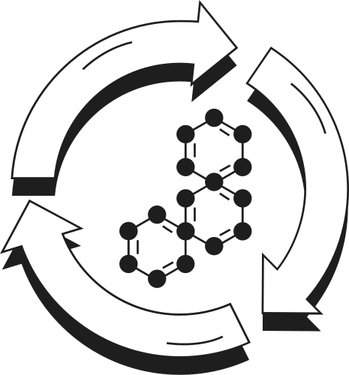

MECHANICAL
PROJECT
SOLAR POWERED CHARGER
Bhanuprakash-PES2UG23EC033
Dheeksha-PES2UG23CS170
Daneshwari-PES2UG23CS160

Slide 2
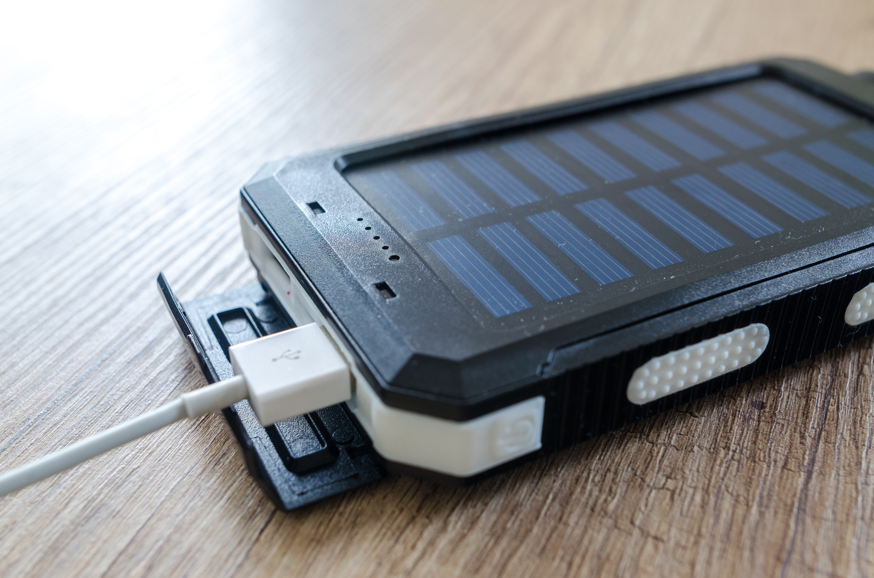
OVERVIEW
Solar-powered chargers harness sunlight to generate electricity for charging various devices.
They are eco-friendly, renewable, and portable energy solutions.
Let's delve deeper into how they work and their advantages.

Slide 3

COMPONENTS OF SOLAR-POWERED CHARGER
Solar Panels: Absorption of Sunlight
Charge Controller: Regulation of Charging Process
Battery: Storage of Electrical Energy
Output Ports: Supplying Power to Devices

Slide 4
WORKING PRINCIPLE
Solar panels absorb sunlight and convert it into DC electricity.
Charge controller regulates voltage and current to prevent overcharging.
Electricity stored in the battery powers devices connected via USB ports.

Slide 5
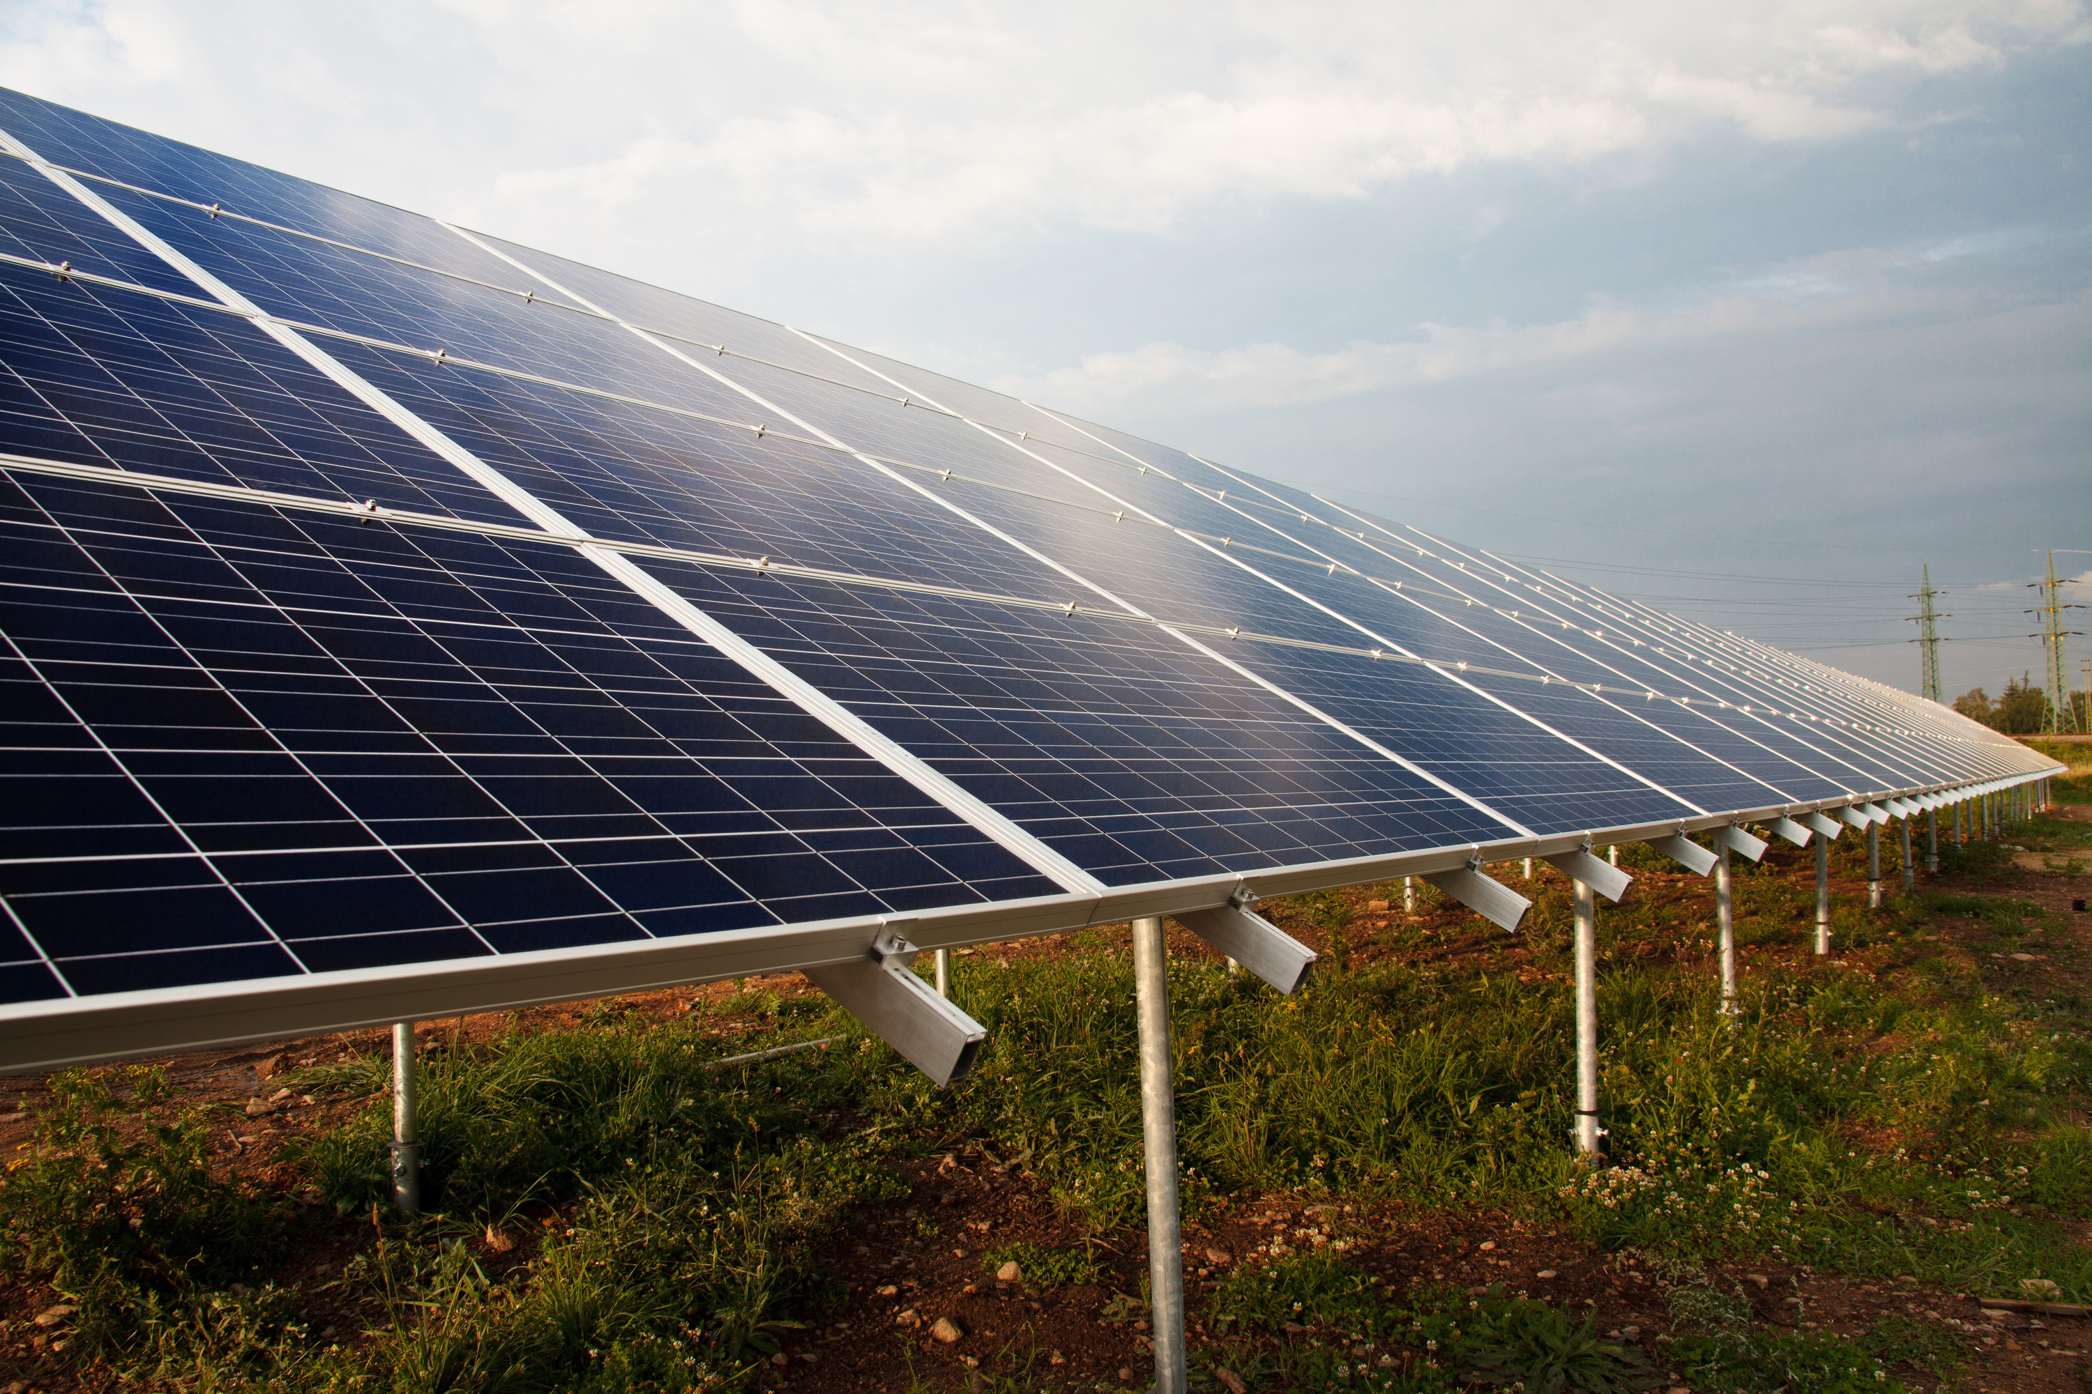
ADVANTAGES
Renewable & Sustainable: Harnesses abundant sunlight
Environmentally Friendly: Reduces carbon footprint.
Portable & Convenient: Ideal for outdoor activities.
Cost-effective: Saves money on electricity bills

Slide 6
Thank you!

